Slide 1
Website Design, Website Development & Software Developmet Company

Slide 2
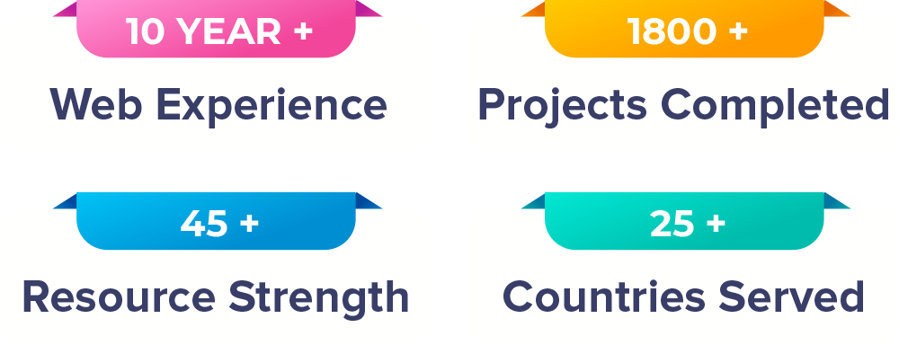
ABOUT DNG WEB DEVELOPER
DNG WEB DEVELOPER is a known andreputed name in the IT industry in Ahmedabad since 2007. A decade of services and solutions par excellence, the huge clientele base with complete customer satisfaction is our motto. Once having worked with us, it is impossible to expect such quality and professionalism elsewhere. Our sheer dedication and expertise has made us a commendable entity in the web development sector and our motto is all-inclusive development with customer satisfaction. Our goal is overarching growth and making a paramount service development entity which caters to all kinds of needs of the customers
We Provide Best Solutions Based Upon Your Needs

Slide 3
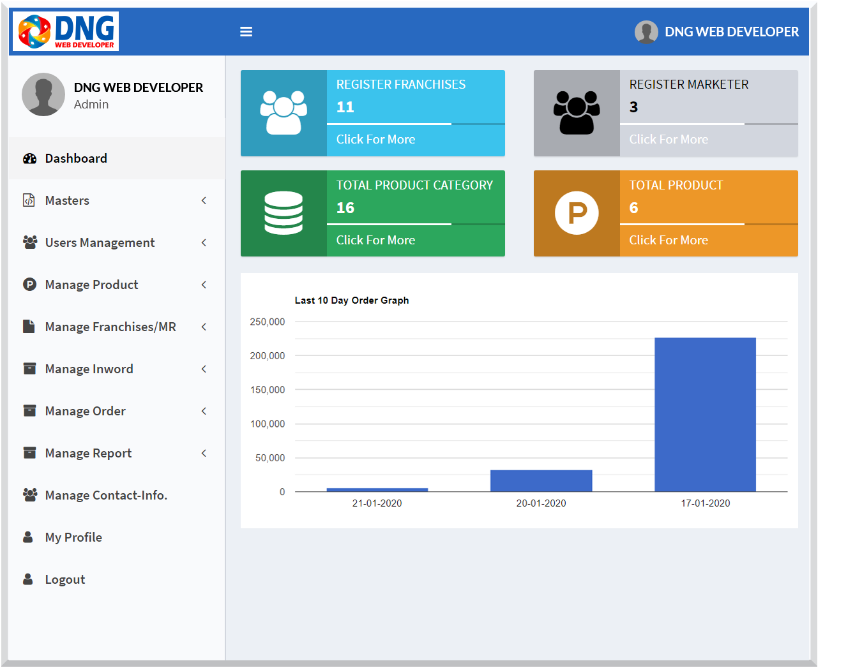
Software DevelopmeNT
MLM Software
Enterprise Solution Software
Sales & Purchase Software
Educational Software
Accommodation Software
Hospital Management Software
Transportation Software
Lims Software
www.dngwebdeveloper.com | +91 98248 90699

Slide 4
WEBSITE DevelopmeNT
Web Portal Development
E-Commarce Web Development
Dynamic Web Development
CMS Website Development
Travel Portal Development
Real Estate Portal Development
E-learning Portal Development
Directory Portal Development
www.dngwebdeveloper.com | +91 98248 90699

Slide 5
WEBSITE DESIGNING
Static Web Designing
Dynamic Web Designing
Responsive Web Designing
Custom Web Designing
CMS Web Designing
E-Commerce Web Designing
Website Redesign
www.dngwebdeveloper.com | +91 98248 90699

Slide 6
DIGITAL MARKETING
Google Adwords
SEO (Search Engine Optimization)
SMO (Social Media Optimization)
Content Marketing
Ecommerce website promotion
Email Marketing
WhatsApp Marketing
www.dngwebdeveloper.com | +91 98248 90699

Slide 7
MOBIAL APP DEVELOPMENT
Android App Development
IOS App Development
Flutter App Development
React Native App Development
IONIC App Development
Hybrid App Development
Mobile App maintenance
www.dngwebdeveloper.com | +91 98248 90699

Slide 8
Website Design, Website Development & Software Developmet Company
11th floor, Capstone Building, Opp. Chirag Mototrs,
Nr. Parimal Garden, Ahmedabad, Gujarat 380006, India

